Slide 1
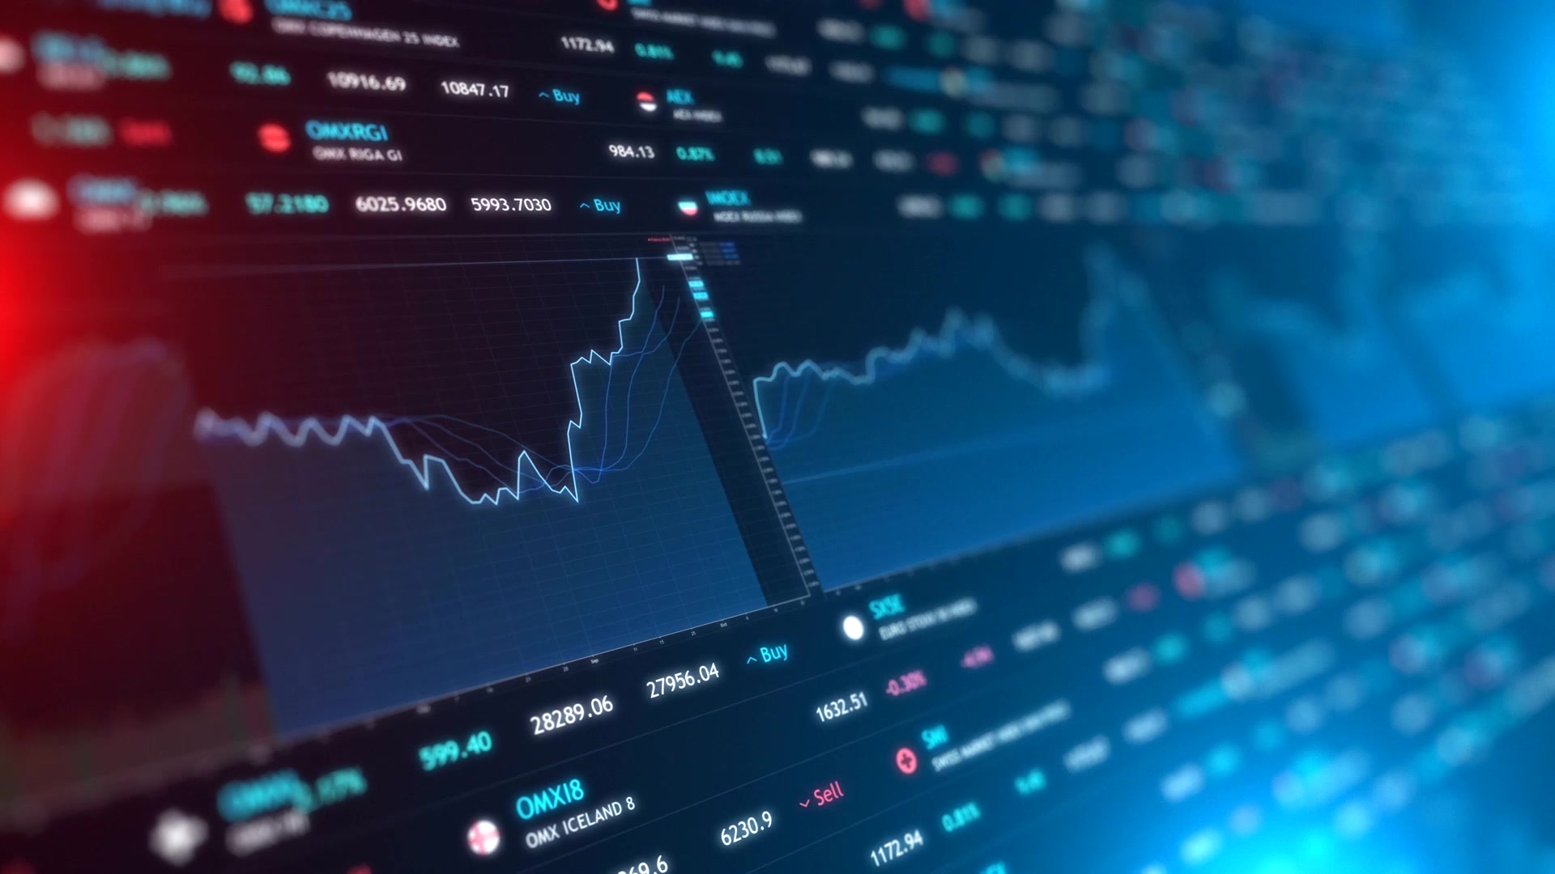

Impact of BIG DATA in capital market
Subject: ALY6000, WINTER 2022
Submitted by: Abhinav Jain
NUID: 002938209
Submitted To: Richard Zhi
Date: 02/16/2022
Introduction To Analytics

Slide 2
Role of Data Analytics in Capital Market
A capital market is a platform where an investor can ‘buy’ and ‘sell’ financial securities such as bonds, stocks, and other securities.
Handle a large volume of data generated through trading
Use of powerful analytical tools like Hadoop, Spark to view trading data
Build trading strategy to fastened the risk management, complex processing for execution of trades
Data-driven insights to discover problems to take competitive advantages
Maintain the transparency of financial data to shareholders, investors, traders
Capital Market
Risk Management
Post-Trade Processing
Market Trade
Client
Relationship
Surveillance
Trading
Key points of Capital Market

Slide 3
Operational Efficiency
Starategy Initiative
Product Developement
Impact of
Data Analytics on
Capital Market

Slide 4
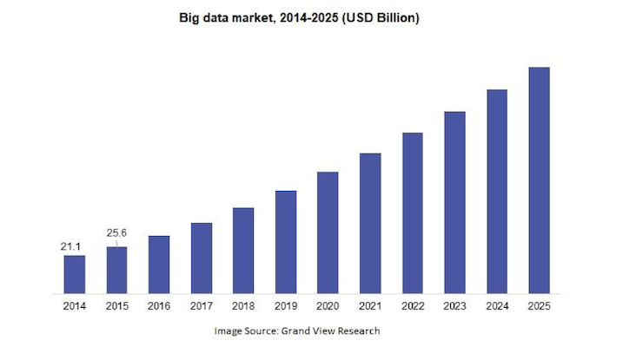
Operational Efficiency
Revenue Optimization, Reporting Requirement, Cost Reduction
Trading Analytics, Research, Client Relationship Management
Strategy Initiative
Safeguard to Investors, Predict Market, Efficient Trades, Sentiment analysis, risk analysis, growth in volume
Primary Market
Product Development
Issue Bonds, IPO, ETF, Trading Equities and Option, Portfolio Management
External Surveillance, Internal Surveillance
Risk Recognition, Post Trade Processing, Market Data management
Secondary Market
123.23
By 2025, the big data market is anticipated to be worth USD 123.23 billion.

Slide 5
Challenges in cultural SHIFT
High Volume Data
Unstructured
Data
Resolution
Old Issues
Inefficiency.
Lack of adequate information about listed companies.
Financial crisis or capital market crash.
Low participation rate.
Low returns on investments.
Lack of transparency and insincerity of stockbrokers.
Poor regulation.
Bad policy.

Slide 6
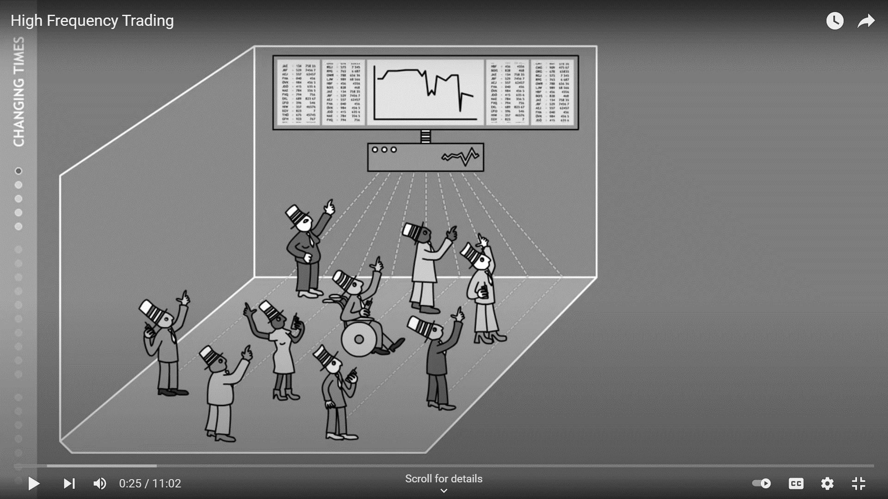
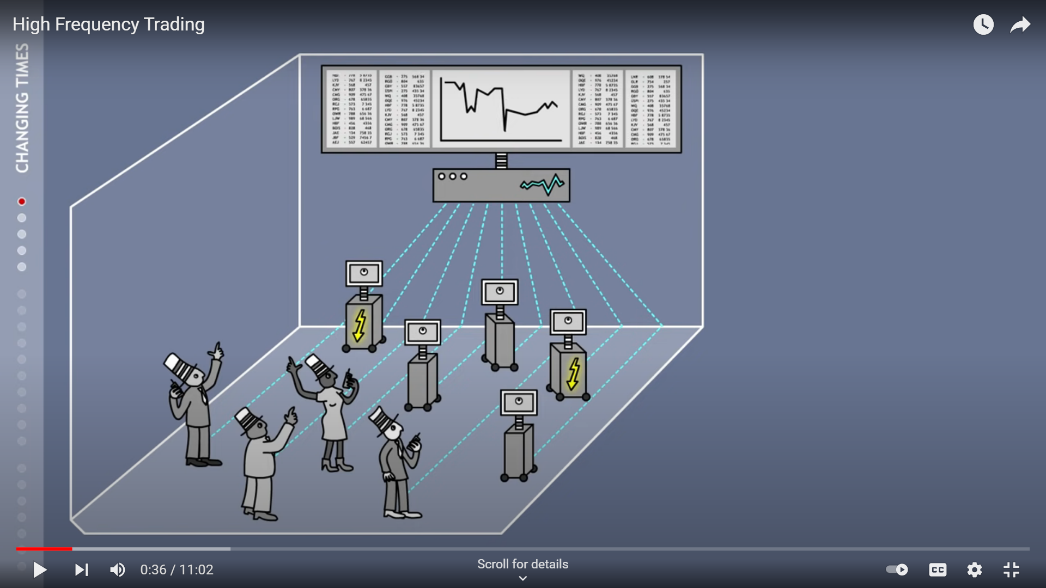
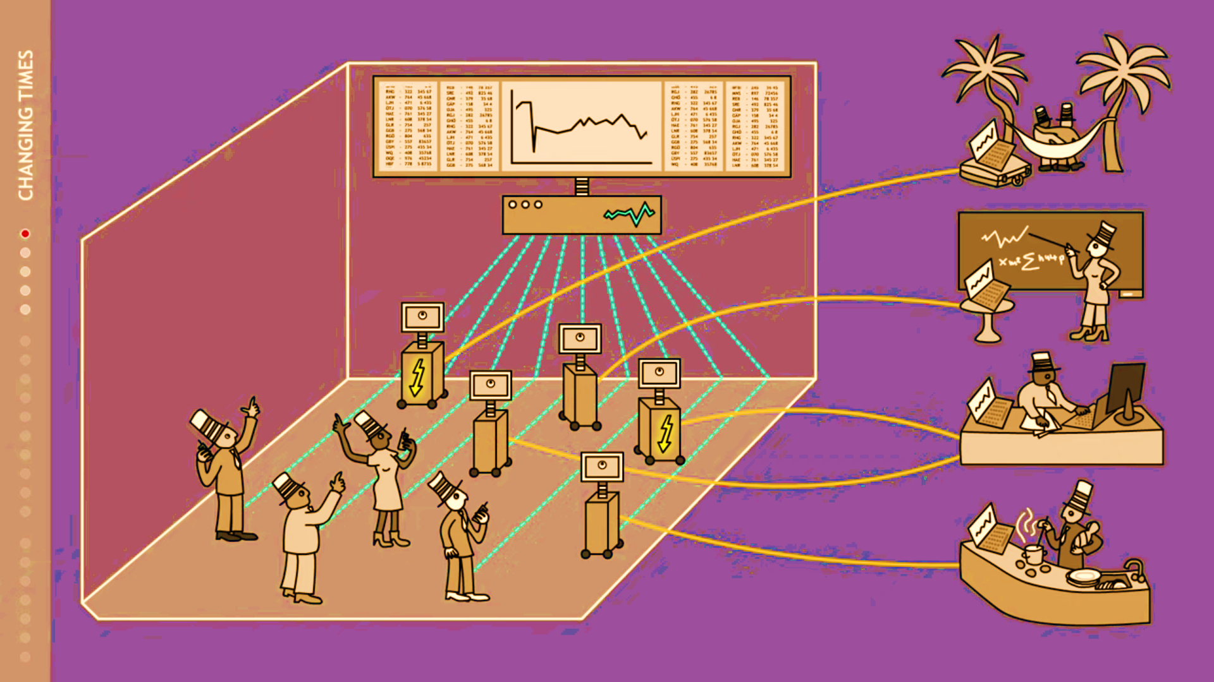
EVOLUTION OF DATA ANALYTICS IN CAPITAL MARKET
Low-Frequency Trading
High-Frequency Trading
Algorithmic Trading
Low-Frequency Trading: on-call trading; Manual trading
Algorithmic Trading: Develop Pre-Programmed Trading Instructions through various indicators
High-Frequency Trading: Buy or Sell Financial Securities tens of thousands of trades per sec
Low-Frequency Trading
Algorithmic Trading
High-Frequency Trading
Note: A data-driven culture has propelled the study area in finance and management with the advent of organized, semi-structured, and unstructured socioeconomic and demographic data via social media, mobile devices, blogs, and microblogs.

Slide 7
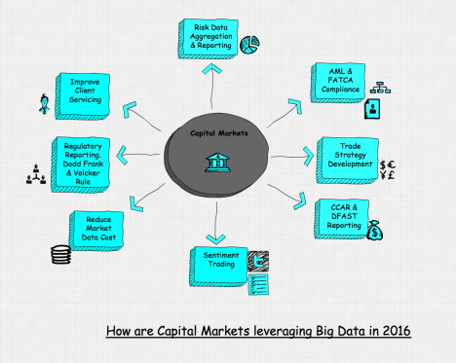
Disruption of big data in capital market
Improve Client servicing
Regulatory Reporting
Reduce market data cost
Sentiment trading
CCAR and DFAST Reporting
Trade Strategy Development
AML&FATCA Compliances

Slide 8
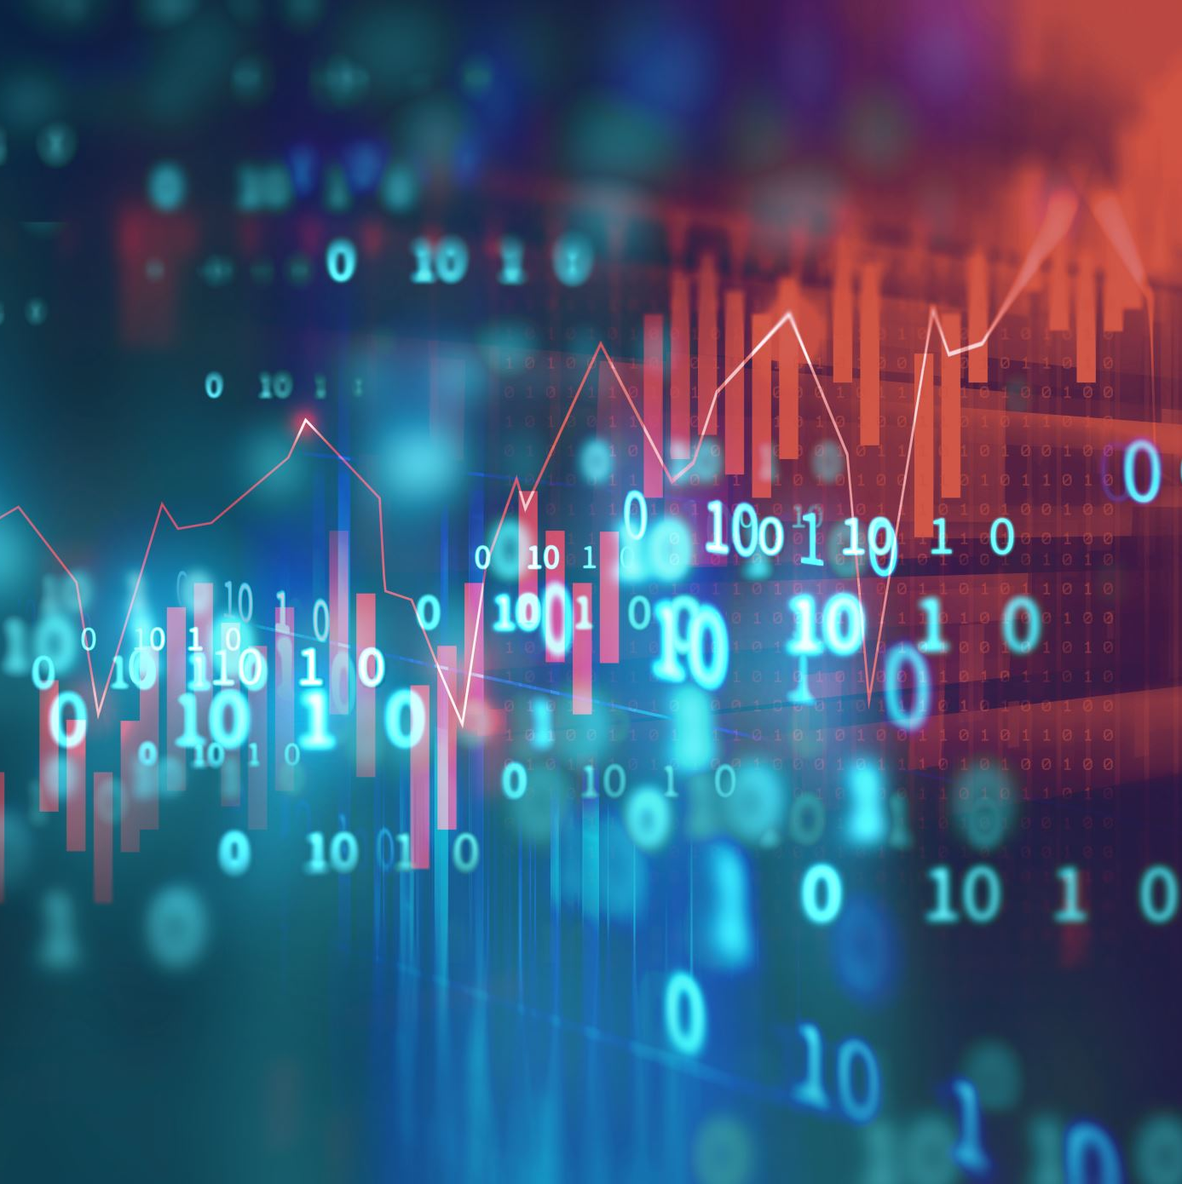
Changes in capital market
Use Big Data: Many data sets from various resources
High-Frequency Trading: Many trades per second (cost margin)
Algorithms: Analyze several markets and place orders based on the current market conditions.
High-Capacity Computer: Using cloud-based technology systems for transferring the data

Slide 9
responsibilities of Equity Data Scientist
Create investment insights based on data from both external and internal sources.
Develop machine learning models based on a variety of data sources to provide our equities investment teams with unique and actionable insights.
Model selection should be based on a proper analysis of machine learning models for statistical significance, as well as the design of appropriate validation and testing methodologies.
Evaluate new internal and external data sets
To support analytics and machine learning model development, lead data cleaning and data integrity projects.
To tackle new and existing difficulties within the Equities Department, clarify business requirements to establish scope and functionality/capability for equities analytics initiatives.
Create visualizations to help a large group of businesspeople exchanges analysis and insights.
Roles
Generate Investment Insights
Testing Models
Evaluate Data Sets
Data Integration and Cleaning
Develop Machine learning Models
Requirement
Analysis
Visualization

Slide 10
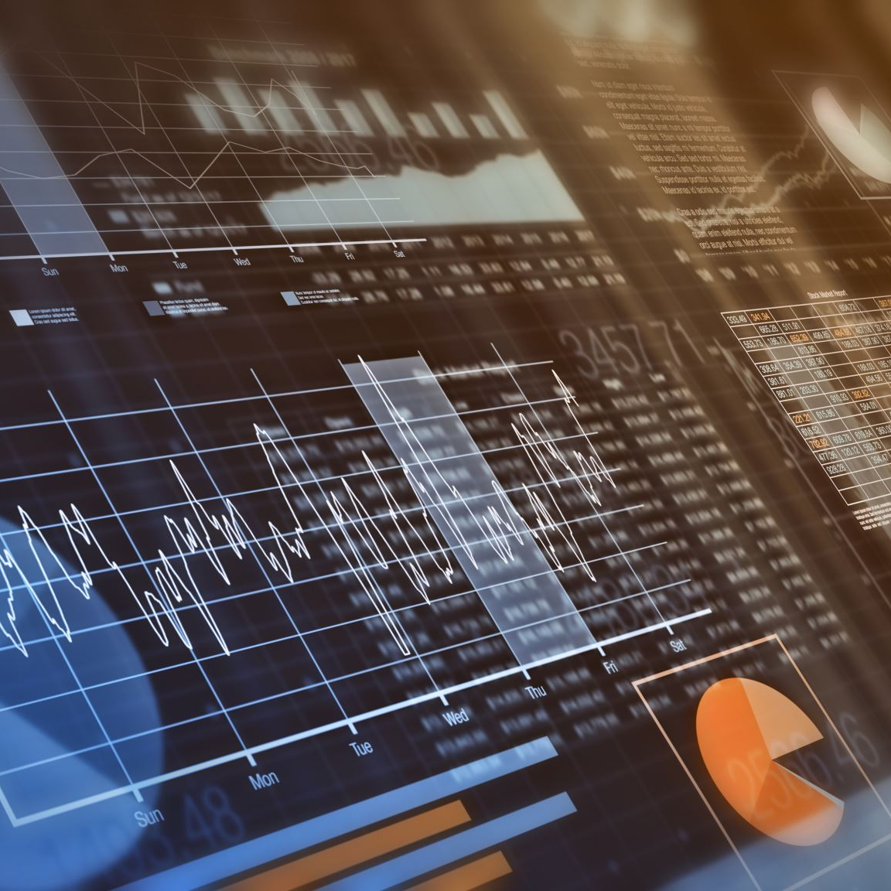
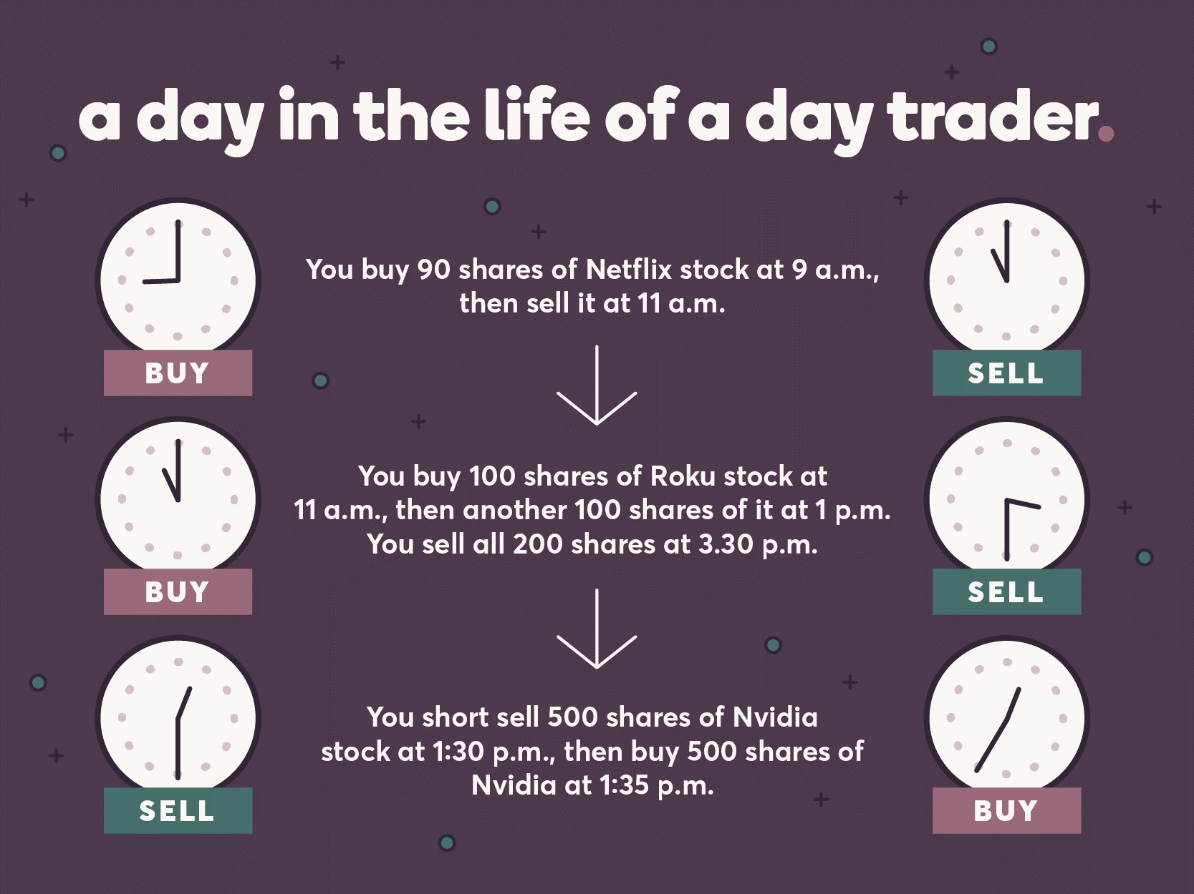
Why equity Data Scientist Inspires
11 Years of domain-specific experience in Capital Market and integration of data science techniques which gives the ability to gain skills that revolutionize the way of trading

Slide 11

References
[1] Impact of Big Data on Business Inc.
https://indatalabs.com/blog/impact-of-big-data-on-business
[2] Operational Efficiency Definition Hayes
https://www.investopedia.com/terms/o/operationalefficiency.asp
[3] Capital Markets Pivots to Big Data in 2016
https://www.vamsitalkstech.com/trade-surveillance/capital-markets-pivots-to-big-data-in-2016/
[4] High-Frequency Trading (HFT) Definition Chen
https://www.investopedia.com/terms/h/high-frequency-trading.asp
[5] 10 Challenges Facing Investors in the Nigerian Capital Market Eze
https://topnaija.ng/10-challenges-facing-investors-nigerian-capital-market/
[6]Algorithmic Trading Definition Chen
https://www.investopedia.com/terms/a/algorithmictrading.asp#:~:text=Algorithmic%20trading%20is%20a%20process,to%20the%20market%20over%20time.
[7] Capital Markets Pivots to Big Data in 2016
https://www.vamsitalkstech.com/trade-surveillance/capital-markets-pivots-to-big-data-in-2016/
[8]https://www.tcs.com/content/dam/tcs-bancs/protected-pdf/Application-of-Data-Analytics-in-Capital-Markets.pdf
[9] https://mail-attachment.googleusercontent.com/attachment/u/0/?ui=2&ik=e26aff4cb6&attid=0.1&permmsgid=msg-f:1724844645145230436&th=17efe110ee9dbc64&view=att&disp=safe&saddbat=ANGjdJ8557XiQbepY8cjE0oRmEogFhwkehqijbJ1swVUKW7COLjEzyzR72_0miy-oTk7qCauQKHdqv4lsjzkN6Gx4ez4vBKFUmjgRr40aIUzSJATedRC8AZIXhhxvz
[10] High Frequency Trading – YouTube This film explains what high frequency trading is, how it affects the financial markets, what negative impact it has and how to regulate it.
https://www.youtube.com/watch?v=z4nCTdQlH8w
[11] Pattern Day Trading Rules: What Investors Should Know
https://www.ally.com/do-it-right/investing/day-trading-rules-and-leverage/

